Slide 1

Group 22 Final Presentation 2nd Year Team Project 2021
By
Shane Mulrooney
Sean Fulton
Cree Gunning

Slide 2


Application Idea
Our Love for games
Fun but challenging experience
No end objective
Round based format

Slide 3
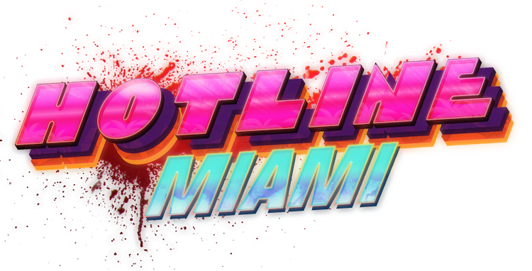
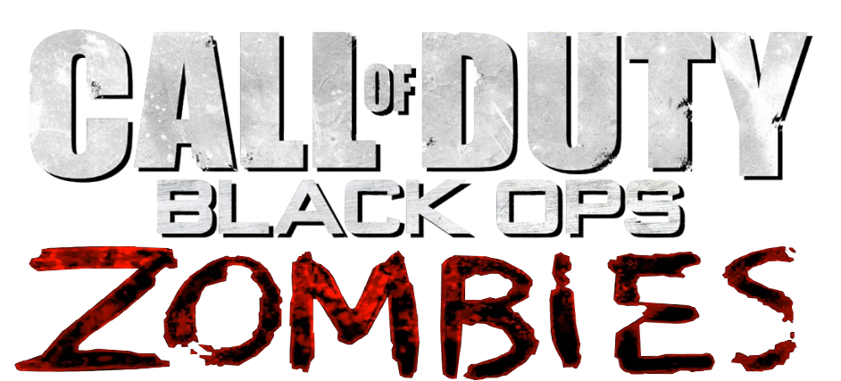
Target Audience
For People Who love games as much as us
Fans of top down style games
Fans of round based survival games

Slide 4

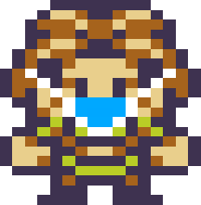
Technology and software used
Game Development Program Godot
Suited the needs and features of our game
Simple Character Animation
Collision Detection
Tile Maps
GDScript flexible and easy to learn

Slide 5
Project Plan
Preparatory Phase Full Understanding of Concept Development of Basic Functioning Game
Finishing Touches Final Testing and Debugging Phase

Slide 6
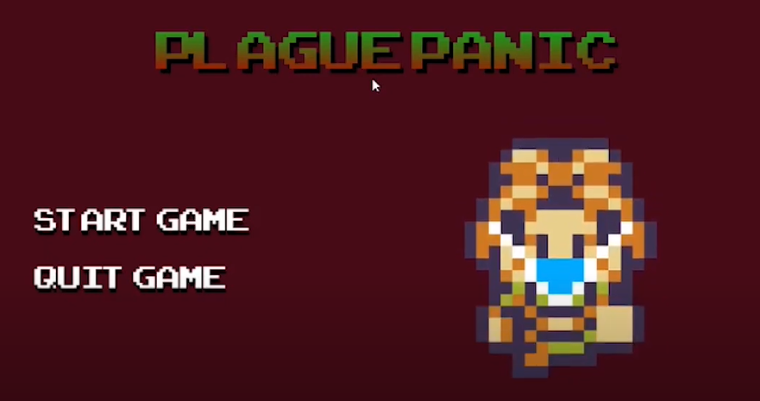
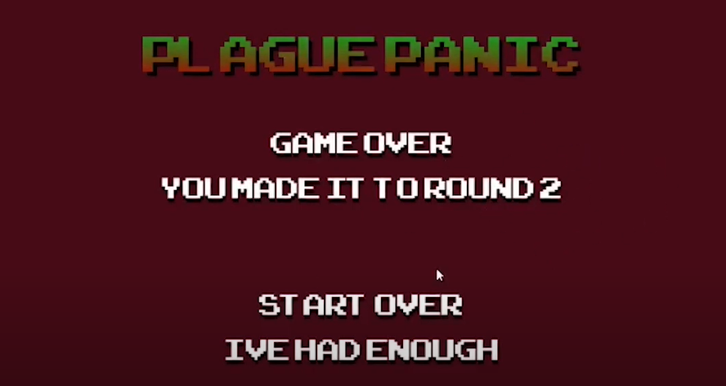
individual responsibilites
Shane
Project manager
Main menu
Cutscene
Game over
Music and sound
Player Walk Mechanic

Slide 7
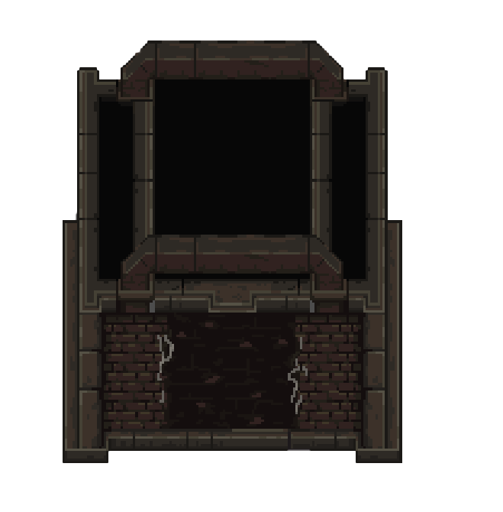
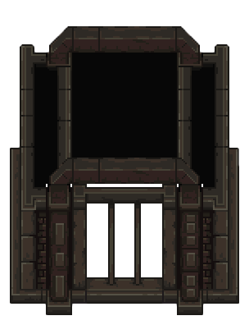
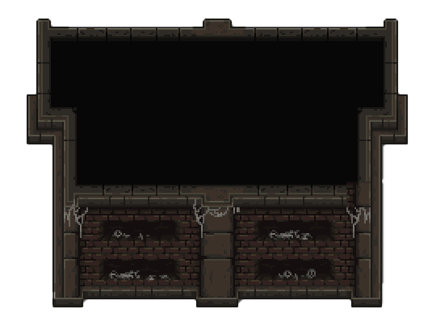
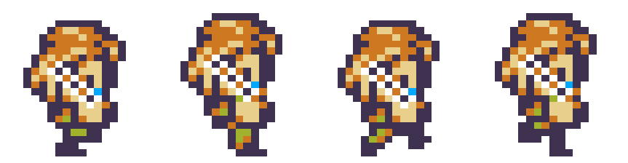
individual responsibilites
cree
Level design
Buildings and decorations
Collision detection
Main character design

Slide 8
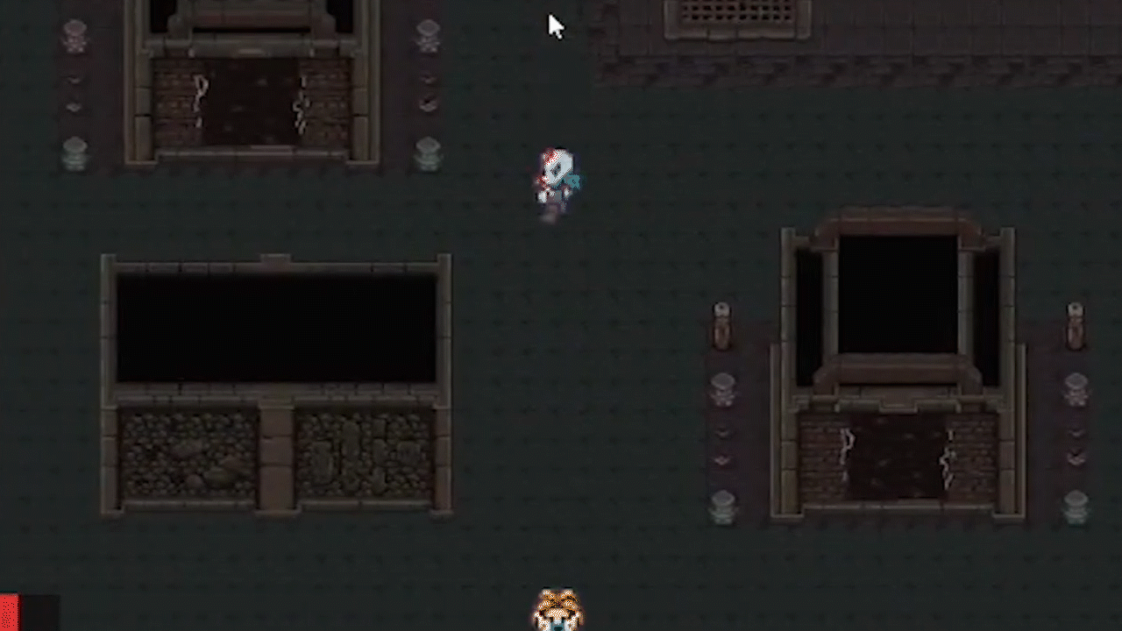
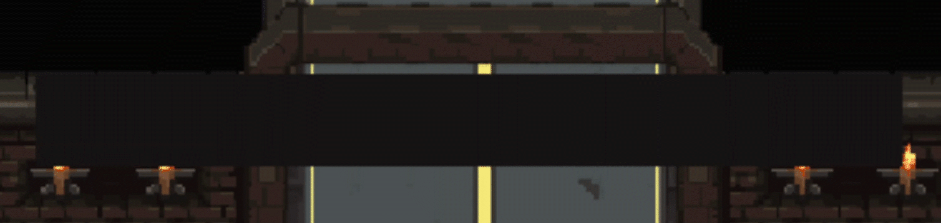
Individual Responsibilities
Sean
Round System
Player Shooting
Enemy movement
Health Bar
Character Attributes
User Interface
Player Shooting:
Health Bar:

Slide 9
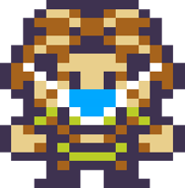
Challenges Overcame
Player Movement:
Implementing player movement was our first major challenge.
Main Level Creation:
Creating the level was our greatest and longest challenge to overcome.
The level had been worked on since the start of the project.
Round System:
Creating the round system was a big task which took quite a bit of code.

